Slide 1
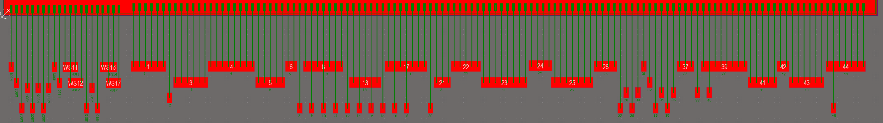
ETROC2 bonding diagram
One row of 17 PCB pads are ground
One row of 13 PCB pads are power supplies
Two rows of 31 PCB pads are signals, pin#40 is GND
Smallest PCB pad size : 5x10 mils
Smallest PCB pad pitch : 10.236 mils (0.26 mm)
Smallest bonding distance : 1.4 mm
Longest bonding distance : 2.451 mm

Slide 2
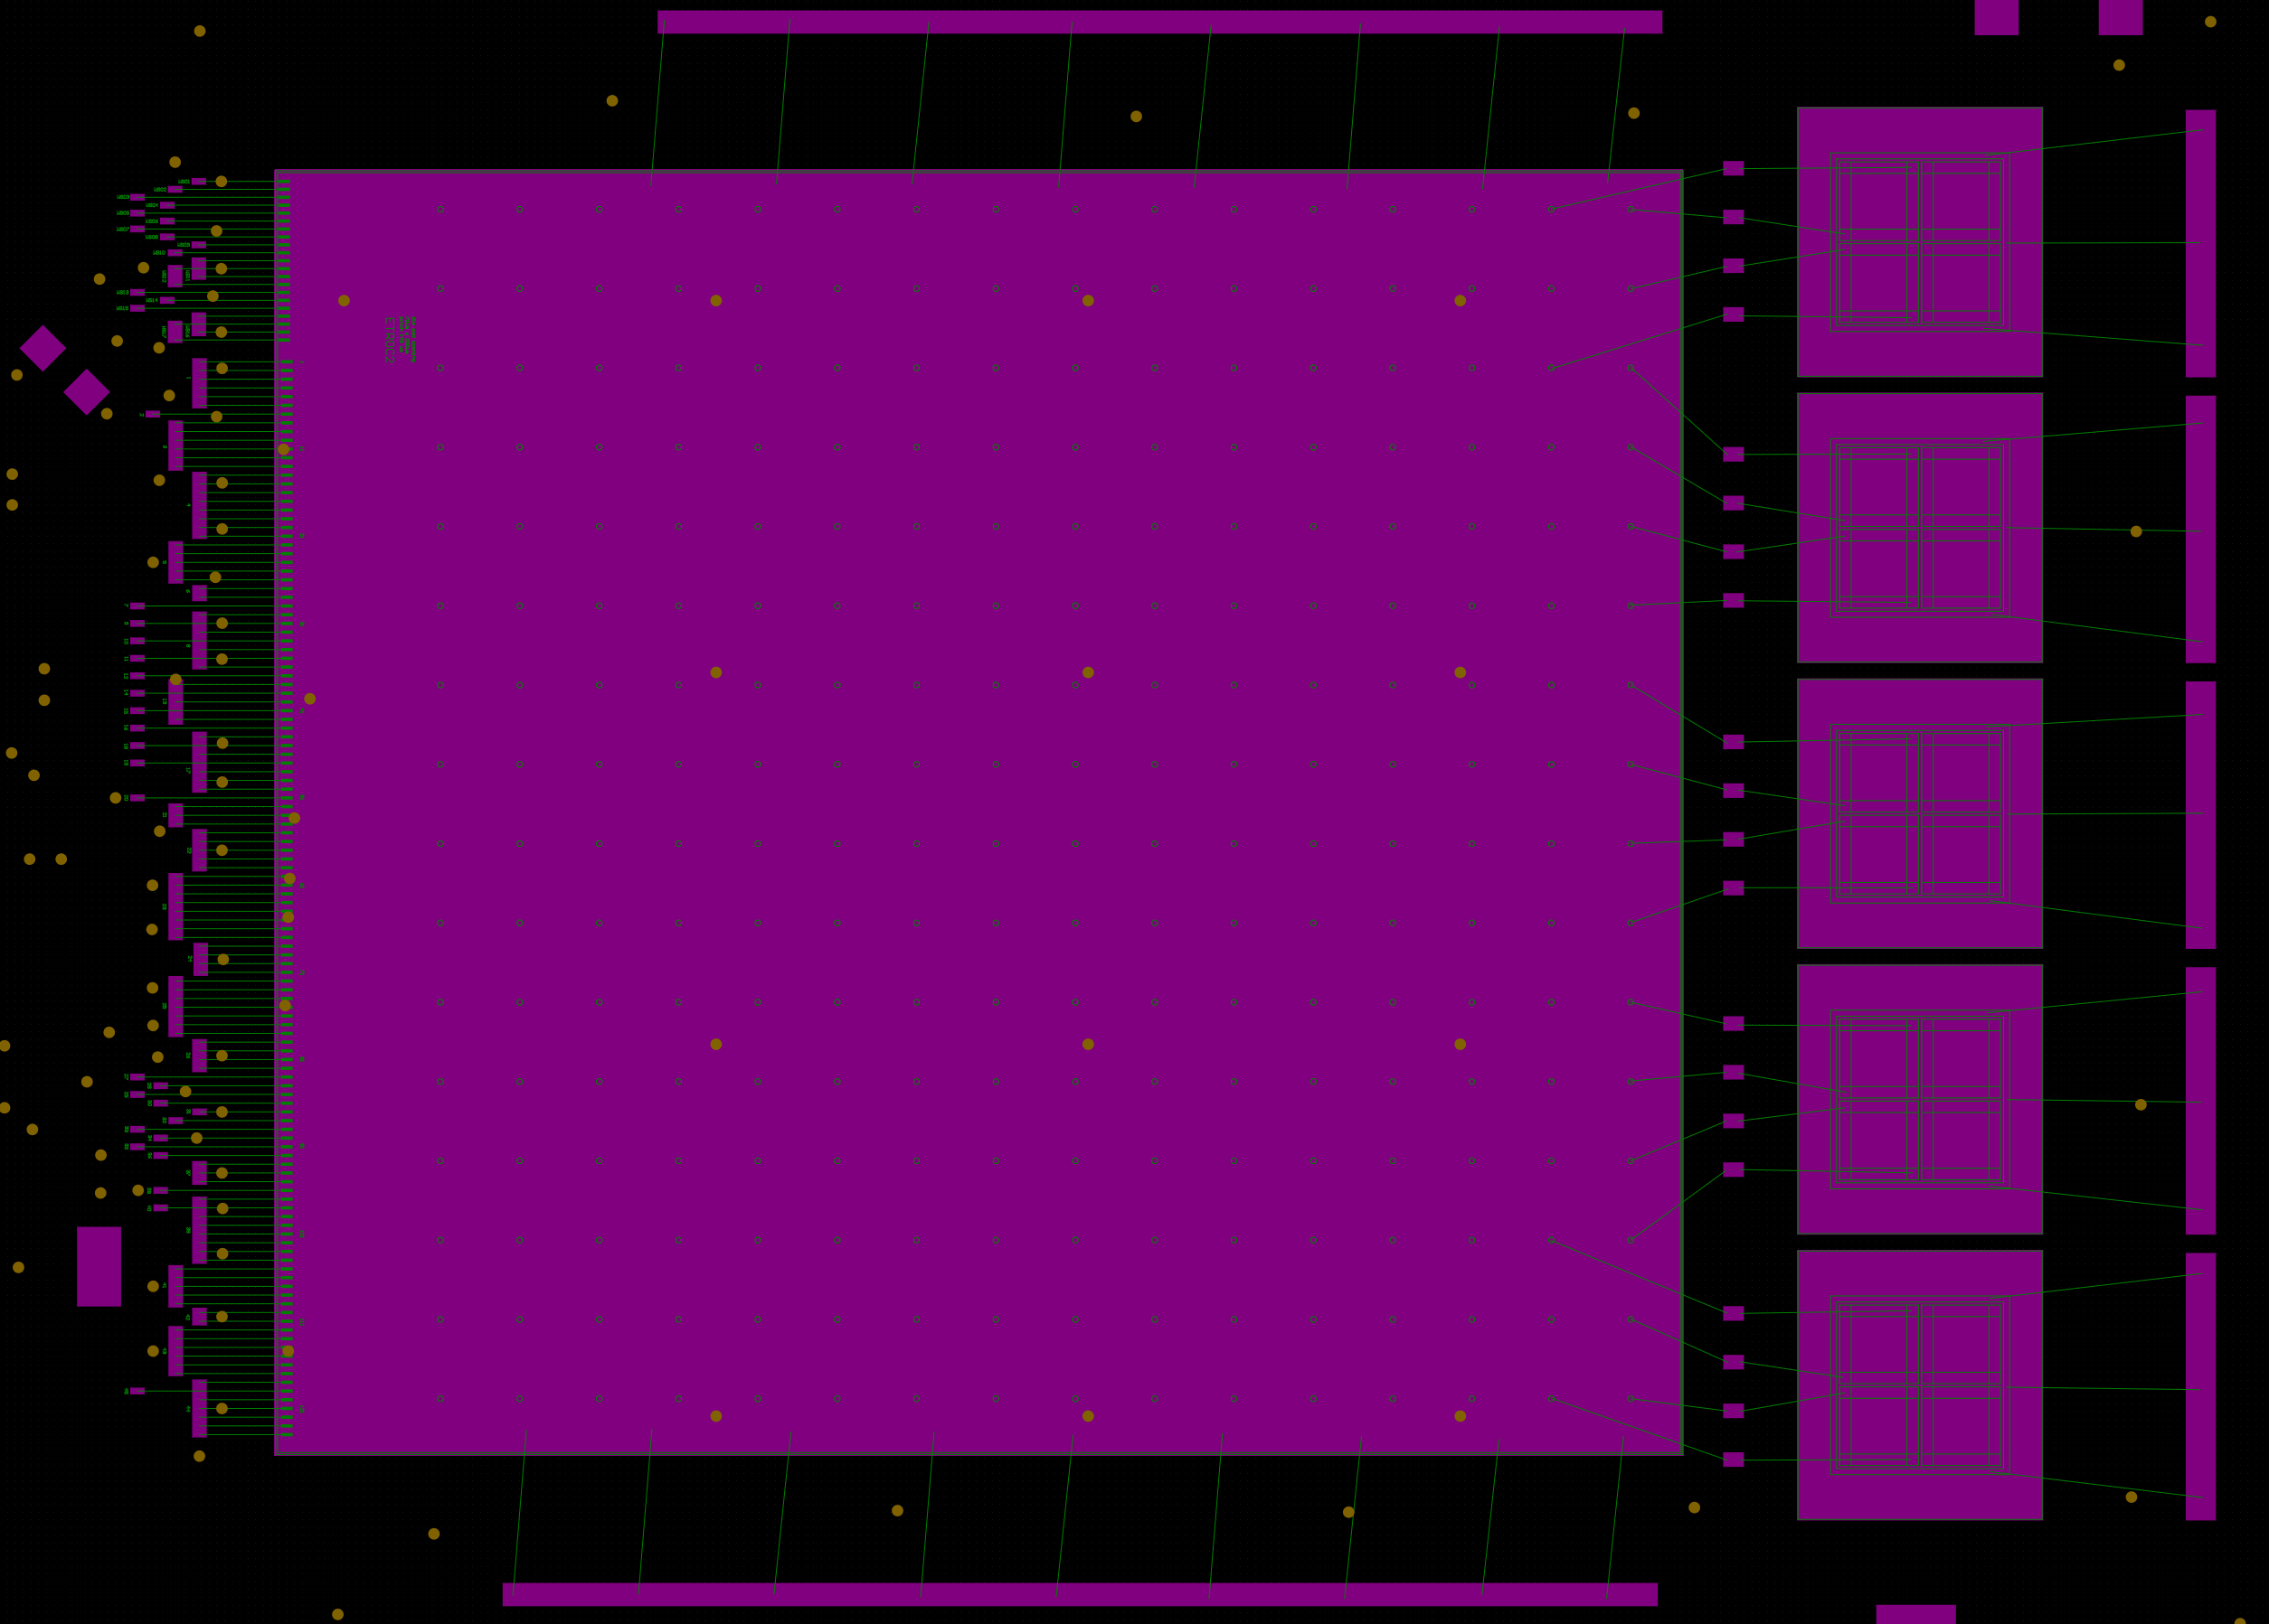

Slide 3
ETROC2
PCB pin# | Pin name | Die pad# | PCB pin# | Pin name | Die pad#
1 | VSS_A | 1-6 | 23 | VDD_D | 60-67
2 | VREF | 7 | 24 | VSS_D | 68-71
3 | VDD_A | 8-13 | 25 | VDD_D | 72-78
4 | VSS_A | 14-21 | 26 | VSS_D | 79-82
5 | VDD_A | 22-26 | 27 | I2CAddr0 | 83
6 | VSS_A | 27-28 | 28 | I2CAddr1 | 84
7 | CLK40p | 29 | 29 | I2CAddr2 | 85
8 | VSS_D | 30,32,34,36 | 30 | RSTn | 86
9 | CLK40n | 31 | 31 | VSS_D | 87
10 | CLK1280p | 33 | 32 | VDD_D | 88
11 | CLK1280n | 35 | 33 | SCL | 89
12 | FCp | 37 | 34 | SDA | 90
13 | VDD_D | 38,40,42 | 35 | I2CAddr3 | 91
14 | FCn | 39 | 36 | I2CAddr4 | 92
15 | DOLp | 41 | 37 | VSS_D | 93-95
16 | DOLn | 43 | 38 | VDD_EFUSE | 96
17 | VSS_D | 44,46,48-50 | 39 | VSS_A | 97, 99-104
18 | DORp | 45 | 40 | VSS_AO | 98
19 | DORn | 47 | 41 | VDD_A | 105-109
20 | VP | 51 | 42 | VSS_A | 110-111
21 | VDD_D | 52-54 | 43 | VDD_A | 112-117
22 | VSS_D | 55-59 | 44 | VSS_A | 118,120-124
 |  |  | 45 | VTemp | 119
Wave Sample
PCB pin# | Pin name | Die pad#
WS01 | DVSS | WS01
WS02 | DVDD | WS02
WS03 | ADDR4 | WS03
WS04 | ADDR3 | WS04
WS05 | ADDR2 | WS05
WS06 | ADDR1 | WS06
WS07 | ADDR0 | WS07
WS08 | WR_EN | WS08
WS09 | DVSS | WS09
WS10 | DVDD | WS10
WS11 | AVSS | WS11,WS13
WS12 | AVDD | WS12,WS14
WS13 | SCL | WS15
WS14 | SDA | WS16
WS15 | RSTn | WS17
WS16 | AVSS | WS18,WS20
WS17 | AVDD | WS19,WS21
PCB-DIE pin map

